Slide 1
Location-Aware Adaptive Vehicle Dynamic System Simulation
Progress Report
Michael Fuller, Dirk Hortensius, Zach Roberts

Slide 2
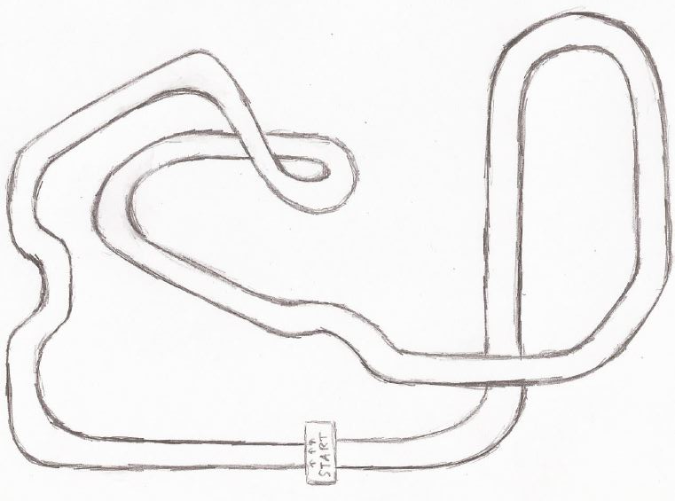
Progress to date
Meeting with VW was a success
Confirmed software choice
Drafts of Viewport and Track ready to produce

Slide 3
Upcoming Tasks
Obtain a license for Simulink 3D Animation to begin simulation development
Create custom 3D models for interior of vehicle and track
Map track position data to Matlab-readable dataset

Slide 4
Potential Issues
Unfamiliarity with development environment
Met with the Mathworks specialist teaching assistant recommended by you (client)
Testing
Since our target audience is very experienced with vehicles, finding a comparable userbase to test our design with may be difficult
Not all the parts needed to test the intervention strategy have been provided

Slide 5
Milestones
Past Milestone: VW Presentation
Future progress is dependent on the client purchasing software
Only deadline is a working simulation by the end of the semester, which needs
Track and Dashboard 3D Models
Input to vehicle simulation model
Realtime view updating to show information from the model

Slide 6
Stretch Goals
Force Feedback Controller
“Ghost Car” of previous lap

